Slide 1
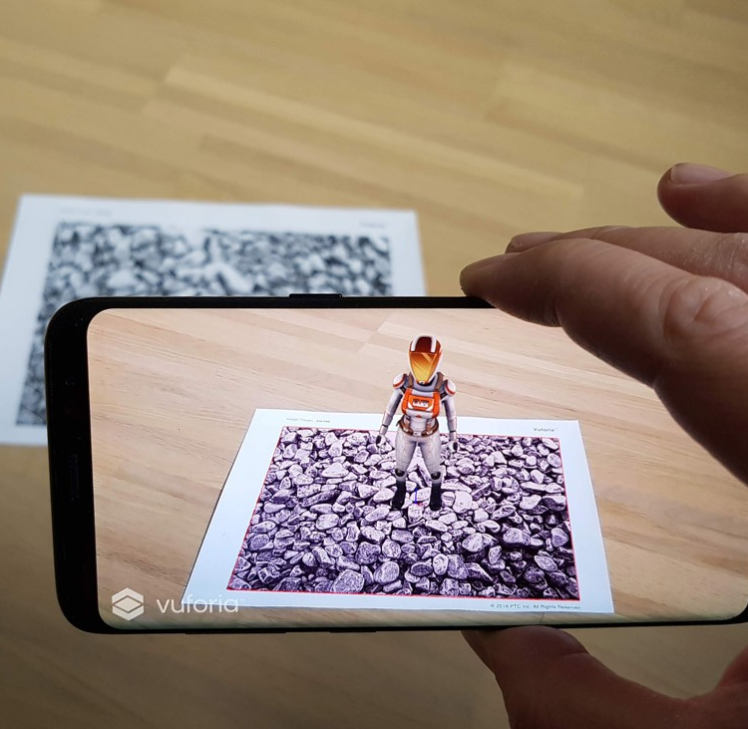
WEEK 2
AGGP 231C
Application Development and Software Prototyping

Slide 2


Vuforia – What is it? [Voo for ee uhhhhh]
An Engine
Recognition and Tracking Technology
Tracking Targets
Model
Area
Image
Object
Multi-Targets
Cylinder
VuMarks
External Camera
Ground Plane

Slide 3
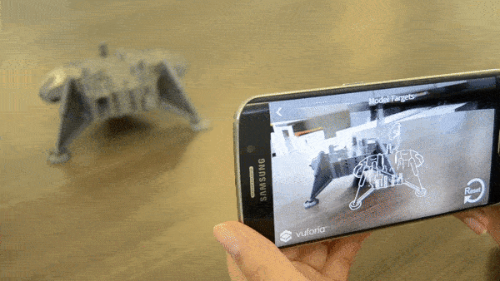
Model Targets
Recognize an object based on shape, based on supplied 3D data (3D CAD model, 3D scan)
Object Must Be:
Be geometrically rigid (i.e. it cannot be deformable or malleable).
Present stable surface features (shiny surfaces are not supported).
Airflow Video

Slide 4
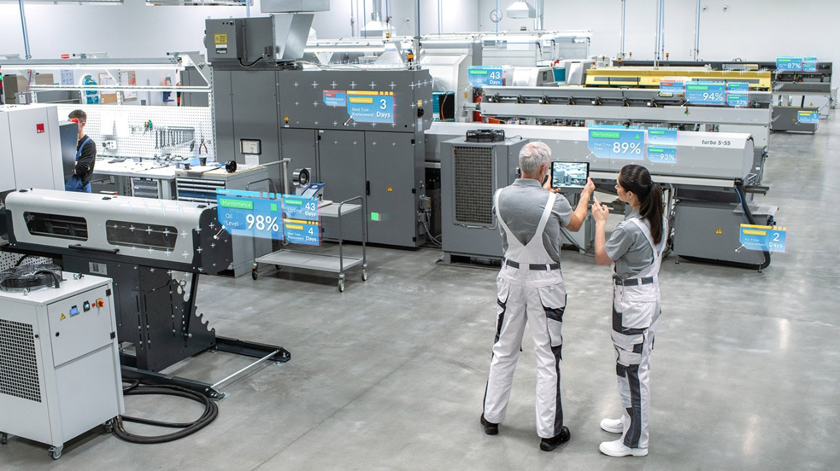
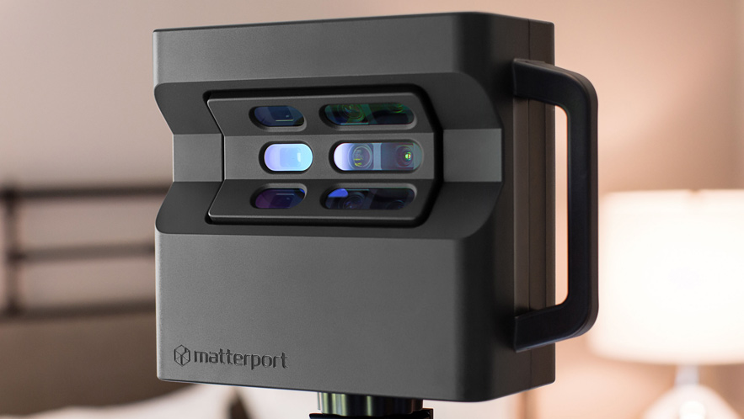
Area Targets
Recognize and track an environment by using a 3D scan as an accurate model of the space to create an Area Target Device Database (Matterport)

Slide 5
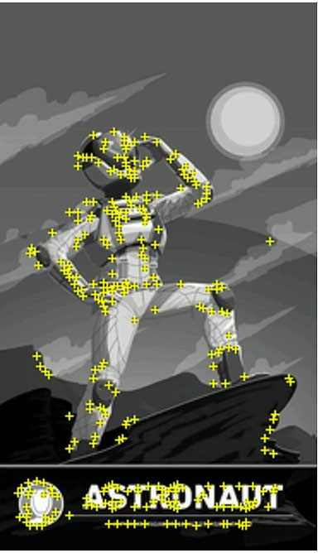
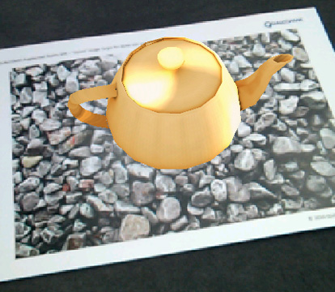
Image Targets
Recognize and track flat images
Images:
Can be black and white or color
Not a repeating pattern
Need to produce a high feature count

Slide 6
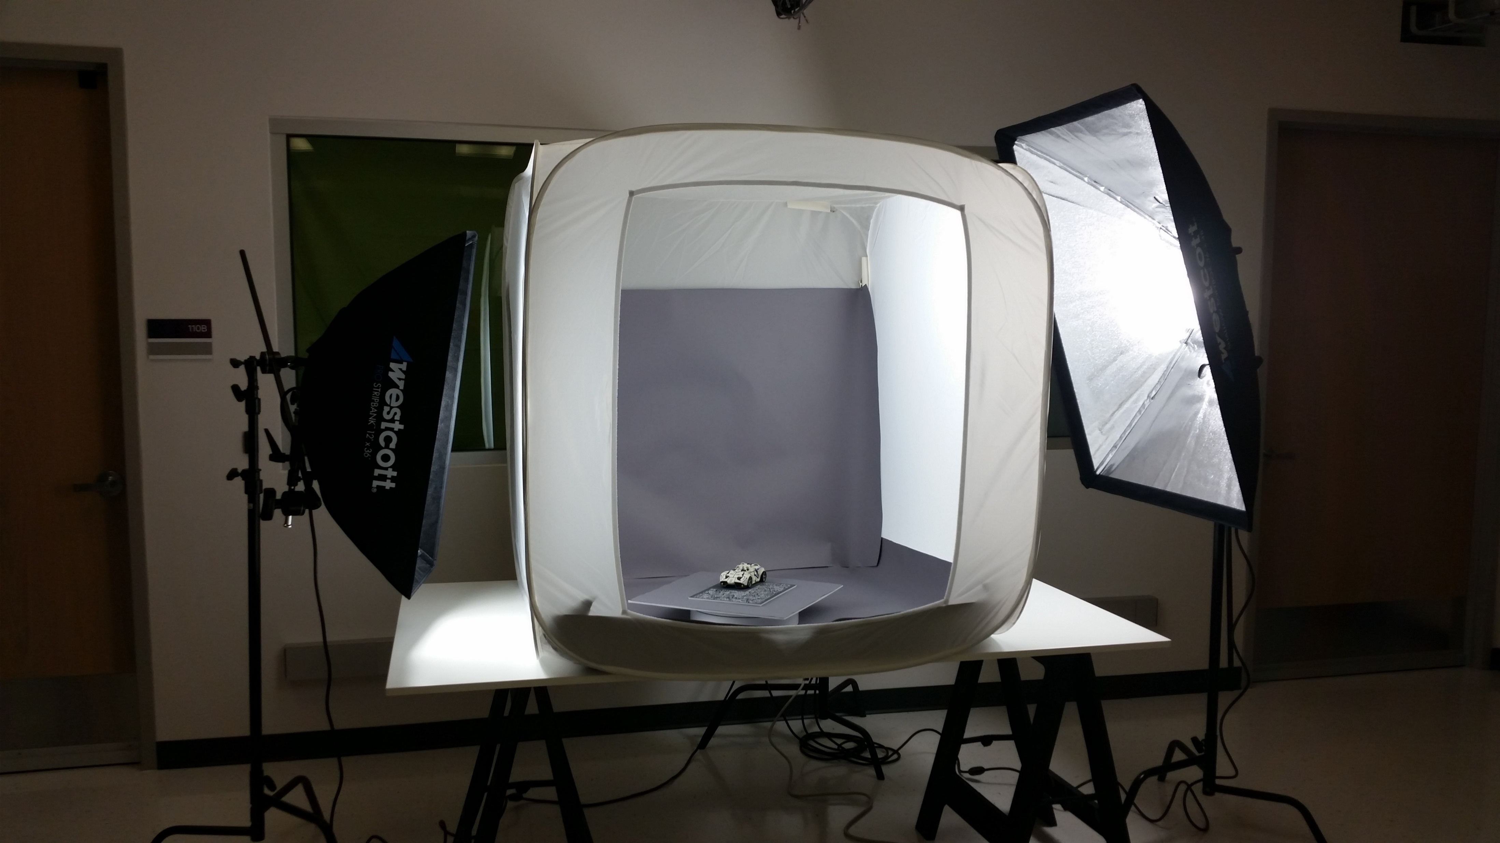
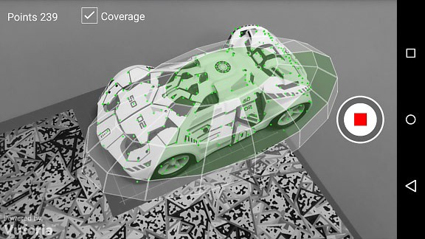
Object Targets
Vuforia Object Scanner scans a physical 3D object, and registers trackable features in an Object Data file

Slide 7
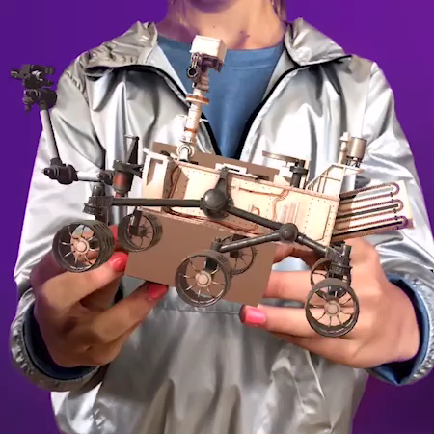
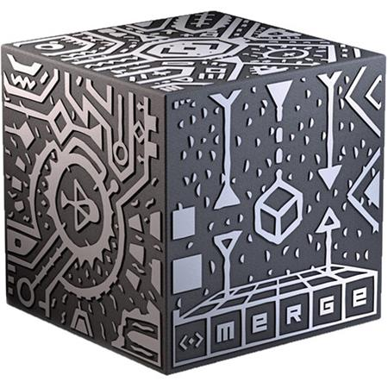
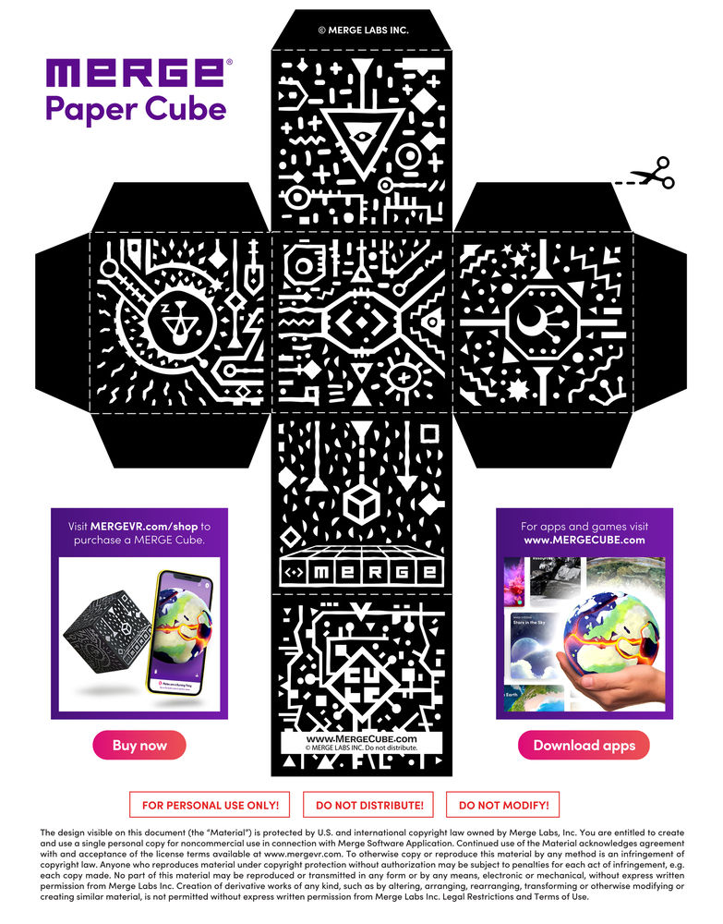
Multi Targets
A collection of multiple image targets combined into a defined geometric arrangement such as boxes.

Slide 8
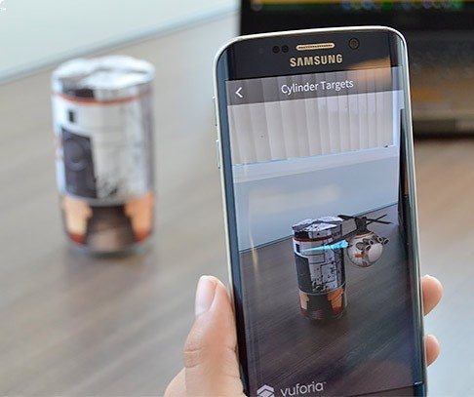
Cylinder Targets
Recognizing images wrapped into cylindrical and conical shapes.

Slide 9

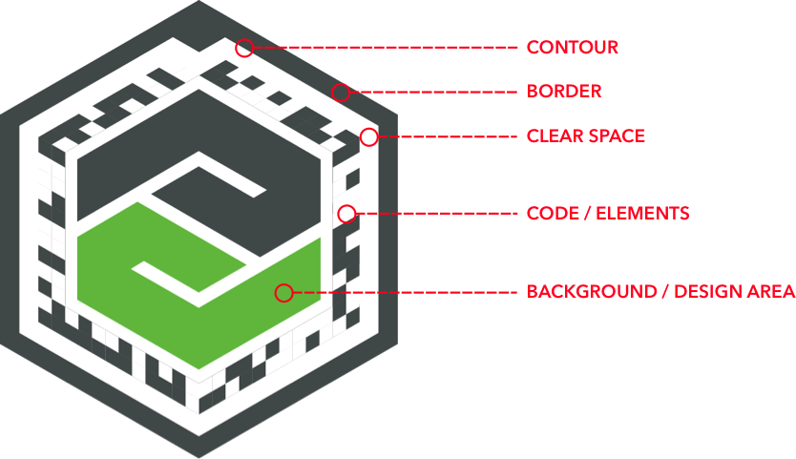
VuMarks
Next-generation bar code.
SVG’s
Designed into logos

Slide 10
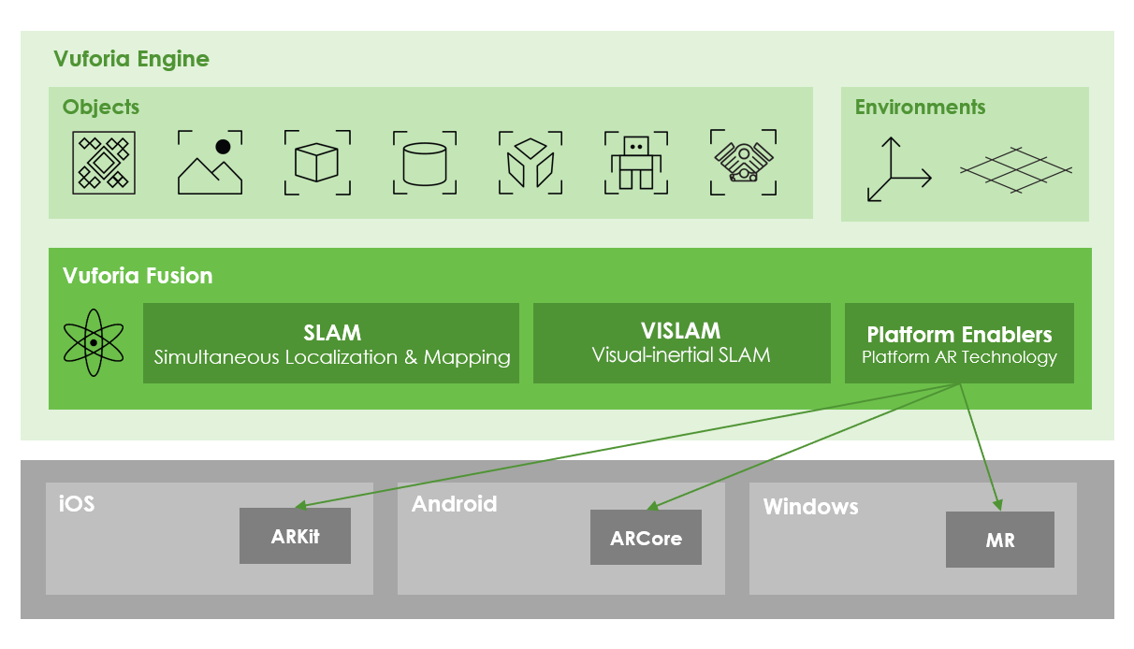
Vuforia Fusion
A set of technologies designed to provide the best possible experience on a wide range of devices

Slide 11

Vuforia – Project Setup
Developer.Vuforia.com
Register a new account (free)
Login
License Manager
devKey
Copy license key
Unity Project
Window > Package Manager
Install Vuforia Package
Window > Vuforia Configuration
Paste new license key text into App License Key text box
ARMaker

Slide 12
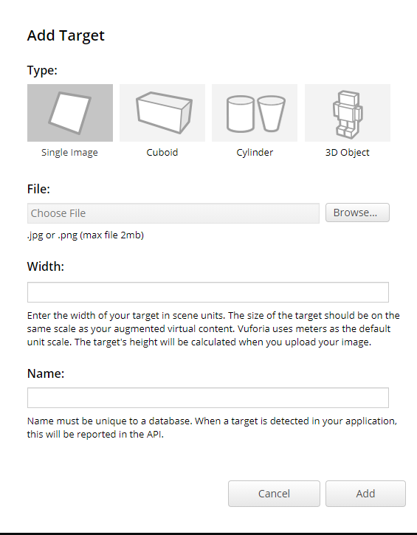
Vuforia – Target Manager
Developer.Vuforia.com
Target Manager
Add Database
Name Database, choose Device, click Create button
Select new Database
Click Add Target button
Select Single Image
Browse to “ar_marker_01_Class.jpg” in Week 2 Assignment folder of class repository
Click Add button

Slide 13
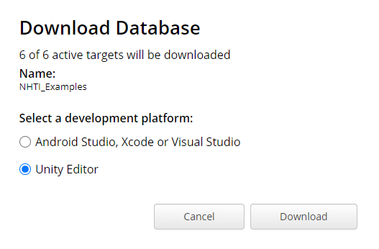
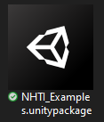
Vuforia – Import Database
Target Manager
Click the Download Database (All) button
Select Unity Editor option
Click Download button
Unity
Assets > Import Package > Custom Package…
Import the database from Vuforia (*.unitypackage)

Slide 14
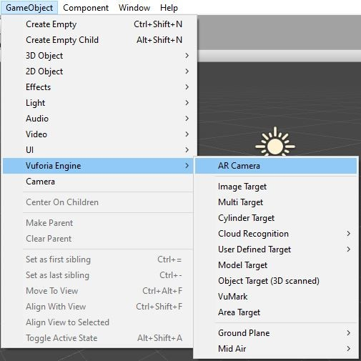
Vuforia – Scene Setup
Delete the Main Camera
Add Vuforia AR Camera in its place
GameObject > Vuforia Engine > AR Camera
Add Image Target
GameObject > Vuforia Engine > Image Target

Slide 15
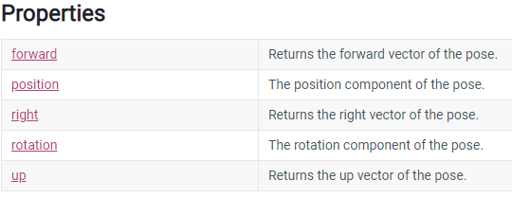
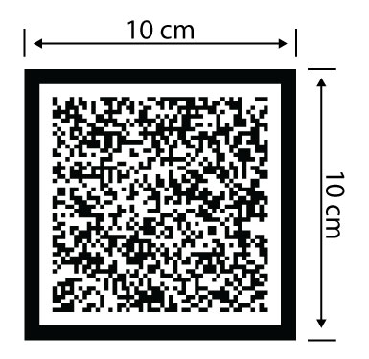
Vuforia – Image Tracking
Pose
Representation of a Position, and a Rotation in 3D Space
Scale
Vuforia goes by METERS
In Unity 1 unit = 1 Meter

Slide 16
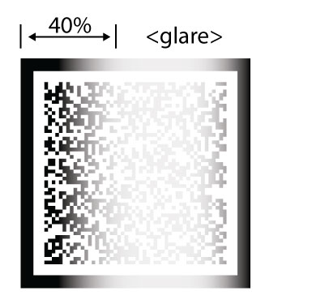
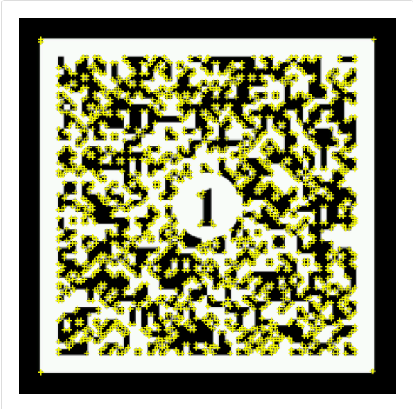
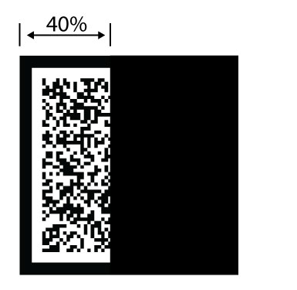
Vuforia – Recognition
Features
Used to ID the target
Unique, non-symmetrical
Visibility
40% of the target
Clearly visible
Glare is bad
Blocked is bad
<blocked>
Features

Slide 17
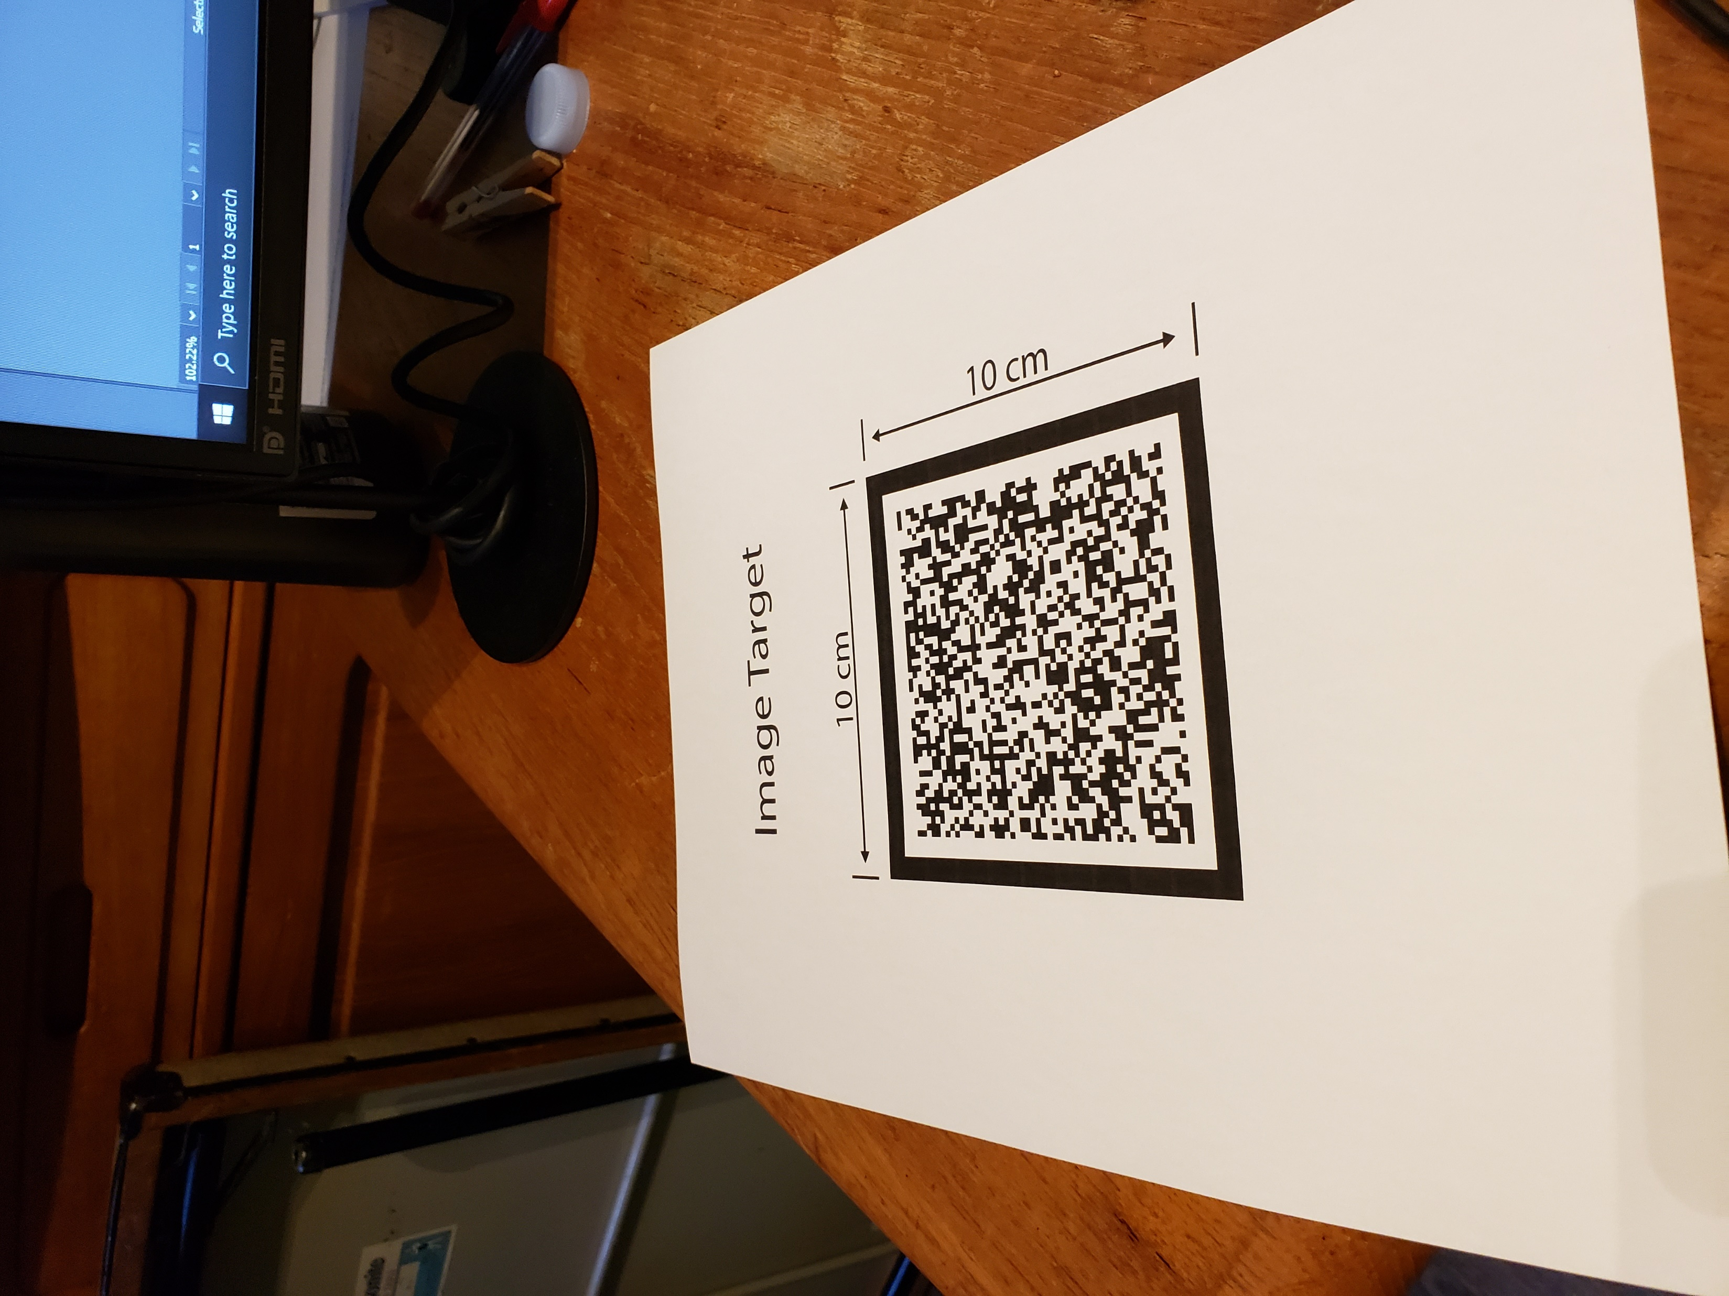
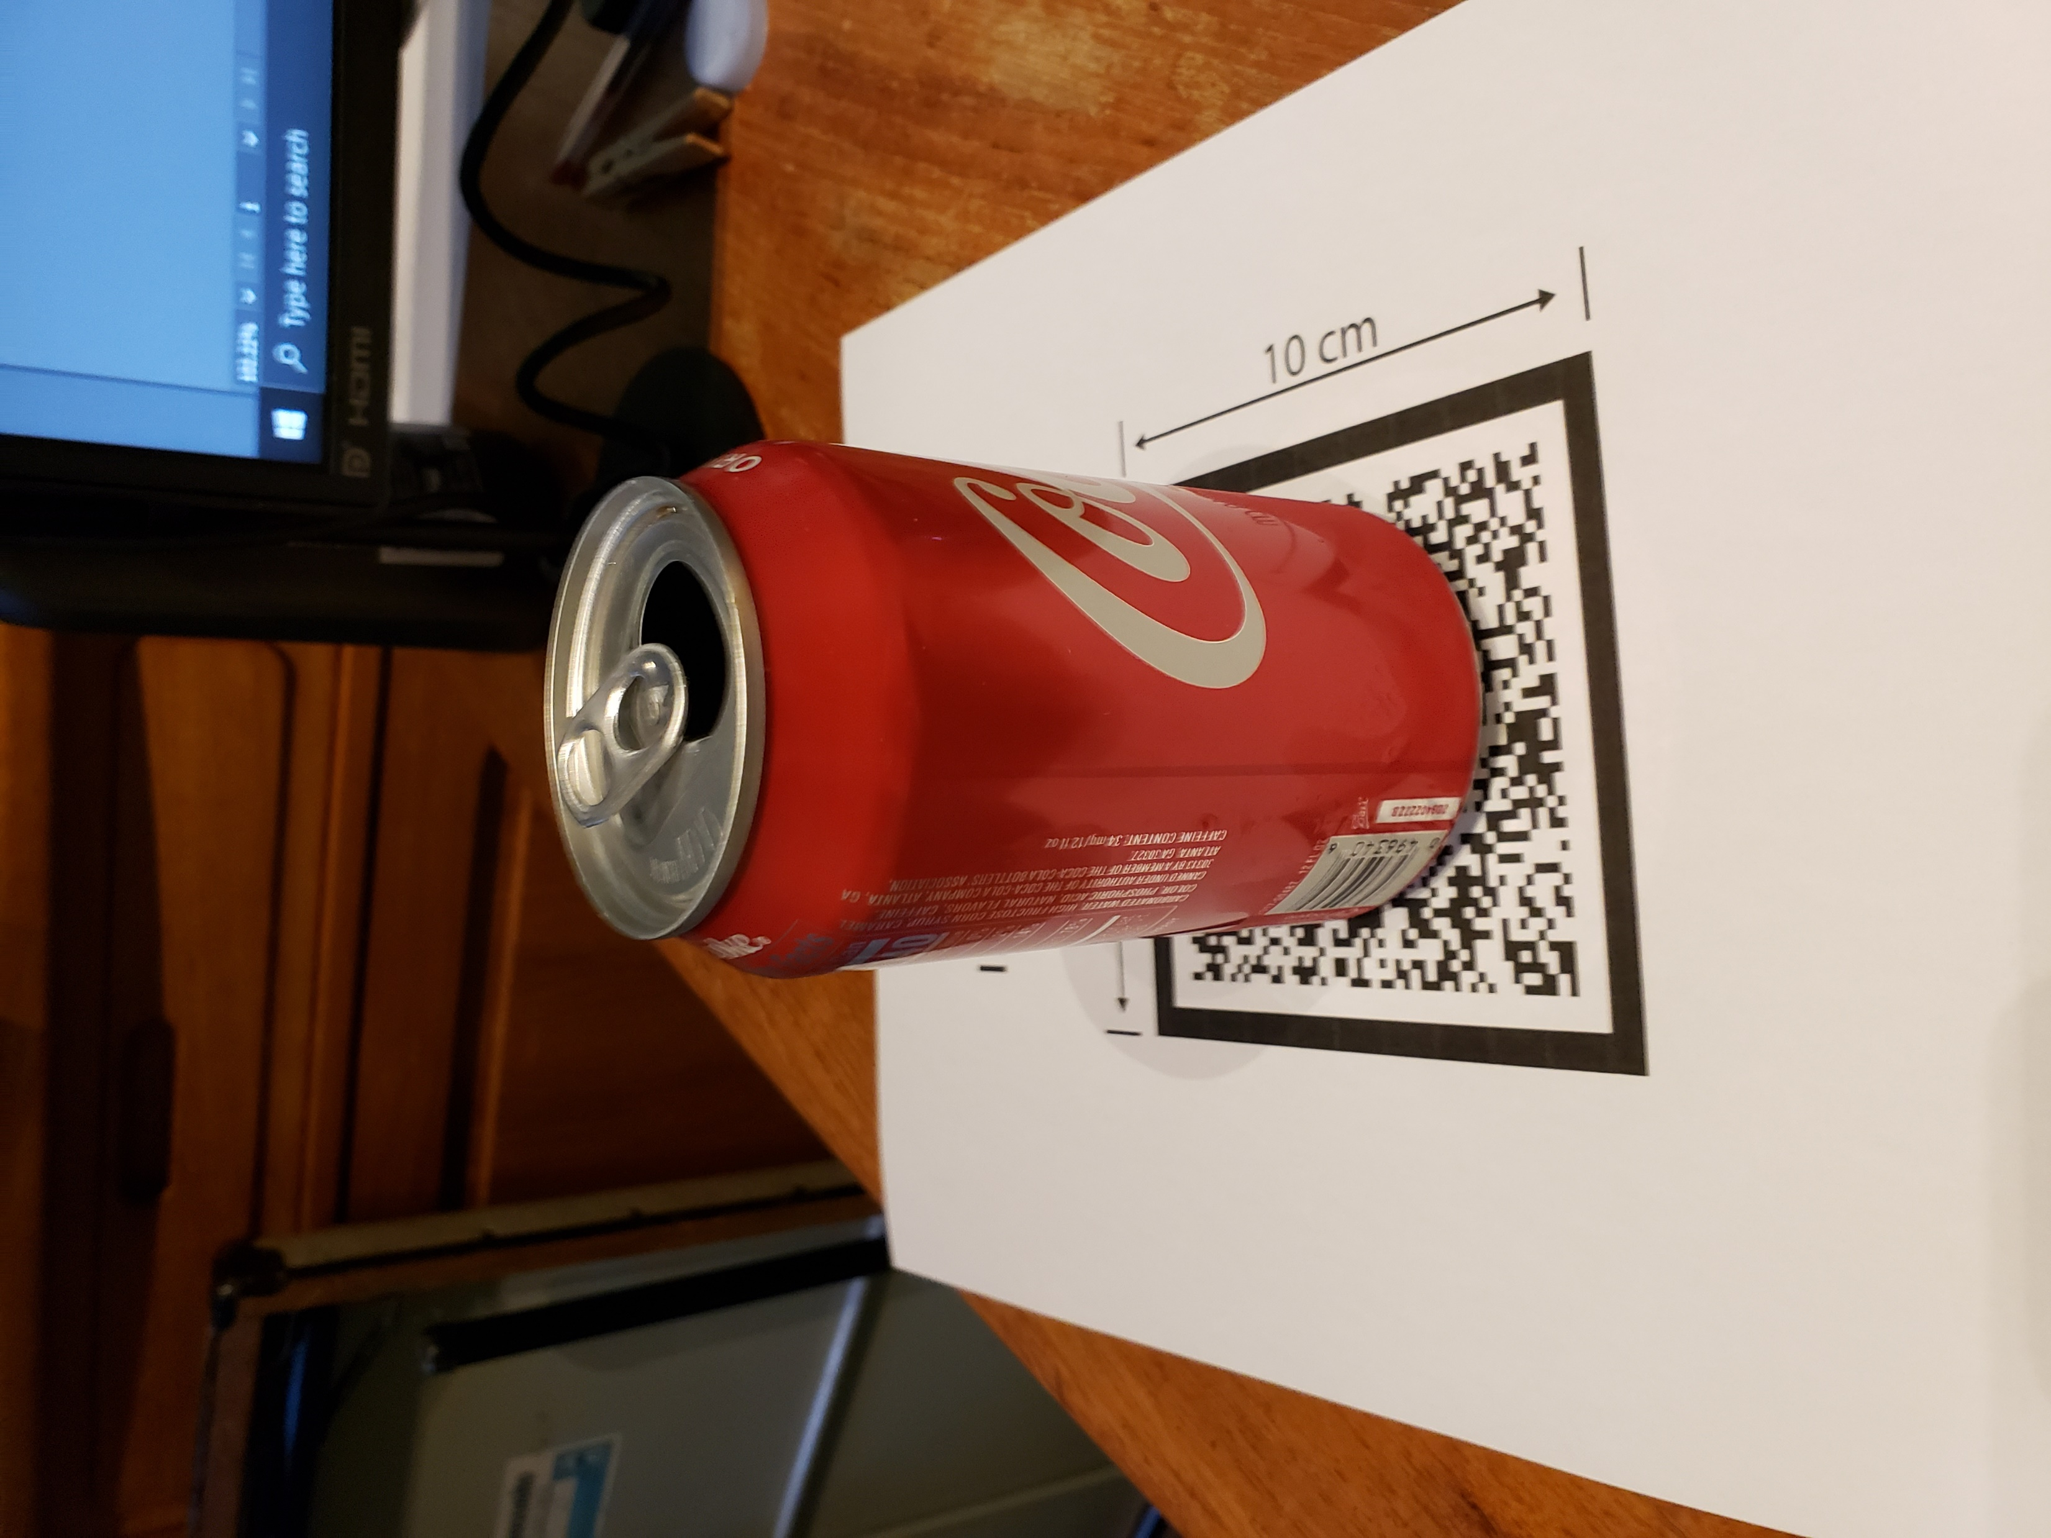
Vuforia – Pose and Scale
Scale
1:1 is HUGE
But scaling down too far will break Unity physics!

Slide 18
Vuforia – Virtual Buttons
ImageTarget
Select Image Target in Scene
In Inspector Window, reveal the settings under Image Target Behaviour (Script) component
Reveal the Advanced options
Click the Add Virtual Button button
Create a script to handle the Virtual Button events
Add this to the Image Target GameObject
BUTTON
Virtual Buttons
Notes:
Preview Material
If you want the button visible, add something else to it
Blocks Features
Place the button over an area that has enough features
Sensitivity
High – a shadow over area may activate it

Slide 19
Vuforia – Virtual Button Design Tips
Attribute | Suggestions
Size | Choose areas in the images that have dimensions of approximately 10% of the image target’s size.
Shape | Make buttons easily identifiable to stand out from rest of image. Highlight active buttons in the augmentation layer to hint at active regions on the target.
Texture or contrast | Avoid defining buttons on low contrast areas of the targets. The underlying target area needs to have sufficient features to be evaluated. Choose a button design that is different in texture from the object that causes the occlusion.
Arrangement on the target | Arrange buttons around the target’s borders with enough space between to avoid losing tracking when the end user presses a button.
Virtual Buttons

